Slide 1

STUDENT AFFAIRS SYSTEM (OİS)
SELECTING COURSES
2020-2021

Slide 2

INFORMATION
Registration renewal (course selection) process for every student in 1st grade, 2nd grade, 3rd grade, 4th grade, in vocational schools and the students who extend school must be performed through the Student Affairs System (OIS) between 15 - 19 February 2021 to avoid loss of term, provided that they also fulfill their financial obligation.

Slide 3
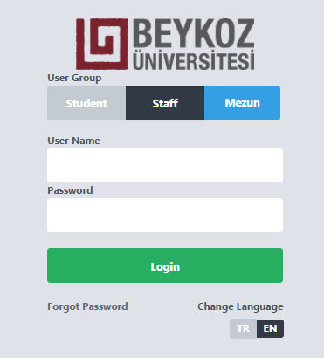

OİS
OİS User Login
You can log in to the system from http://ois.beykoz.edu.tr or www.beykoz.edu.tr homepage by clicking the OIS text in the menu of ‘Our Students.’ menu.
You must enter your username as "name surname"
combined and without using Turkish characters. Your password is provided in the first registration.
If you do not remember your password, you can click the "Forgot My Password" link to receive your new password as an SMS.

Slide 4
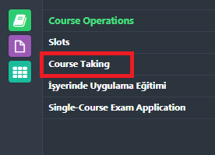
OİS / COURSE SELECTION
After logging in with your username and password, click on the Course Selection screen on the first icon. Again, you can see and check all the courses you have previously taken or have to take from the Slots in this icon.

Slide 5
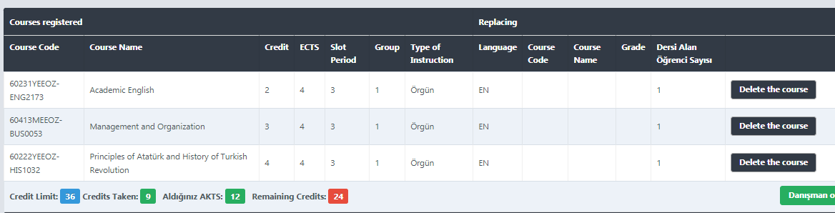
OİS / COURSE SELECTION
After the student has selected all the courses to which she / he will be registered to, she / he clicks on the Send to Advisor Approval button for the advisor approval of course registrations. After submission, it appears as Advisor Approval Status: Pending.
Advisor Approval Status of the student approved by the course registration advisor then changes to Approved and the student is registered in classes.

Slide 6
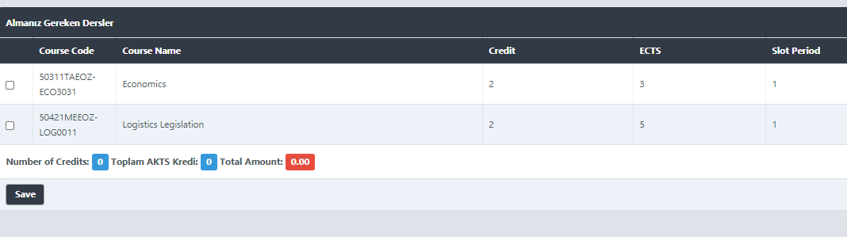
Our students who extend their school in Vocational School; From the Course Selection screen, they can see all the courses they failed or could not be taken before. When they mark the courses they want to choose, they will be able to see how many credits they have chosen and their prices. They must make the payment to the Financial Affairs Directorate by clicking "Save", enter the OIS again and absolutely send their courses to the approval of the advisor. Thus, final registration for the courses will be made.
OİS / COURSE SELECTION

Slide 7
RULES
OİS / COURSE SELECTION
According to the Beykoz University Bachelor and Associate Degree Education Regulation ARTICLE 20 "Student workload and course taking conditions"
I. Students with a GPA of 1.79 out of 4.00 or less, can take up to 30 ECTS,
II. Students with a GPA between 1.80-2.49 over 4.00 can take up to 36 ECTS,
III. Students with a GPA of 2.50 out of 4.00 or above, can take up to 42 ECTS,
IV. Graduating students can take courses from lower and / or upper semesters can take up to 42 ECTS regardless of their cumulative grade point average, provided that they do not exceed the maximum workload.
Students can only choose 1 course from the University's Competence and General Education courses (Elective Course Pools). The course to be selected should not be one of the compulsory courses taken before.
If they wish, students can take the courses they have been successful in the fall semester to raise their grade point averages. The higher grade of the course (s) taken is recorded in their transcript.

Slide 8
RULES
OİS /COURSE SELECTION
In order to choose the "Practice Training in the Workplace" course;
The GPA must be 1.50 and above.
The student should not be subject to disciplinary punishment (suspension) during the semester of practical training.
The maximum number of courses missed or not taken at all should be 2, and students who have more than 2 courses must first complete the courses they have taken before, failed or could not take. Graduating students can take courses up to 42 ECTS regardless of the number of courses they have failed due to absenteeism or have not taken at all.
Failed courses that do not require attendance are automatically assigned in the system and there will be a «Delete Course» button next to the courses. The student will be able to choose the Practice Training in the Workplace course if the student meets the workload and course taking conditions. If the ECTS credits are not enough, they will be able to select the Practice Training in Workplace Practice by deleting the automatically assigned courses.

